Slide 1
CSC 112: Computer Operating Systems Lecture XX Scheduling
Department of Computer Science,
Hofstra University
Acknowledgement: Lecture slides based on UC Berkeley CS 162: Operating Systems and System Programming

Slide 2
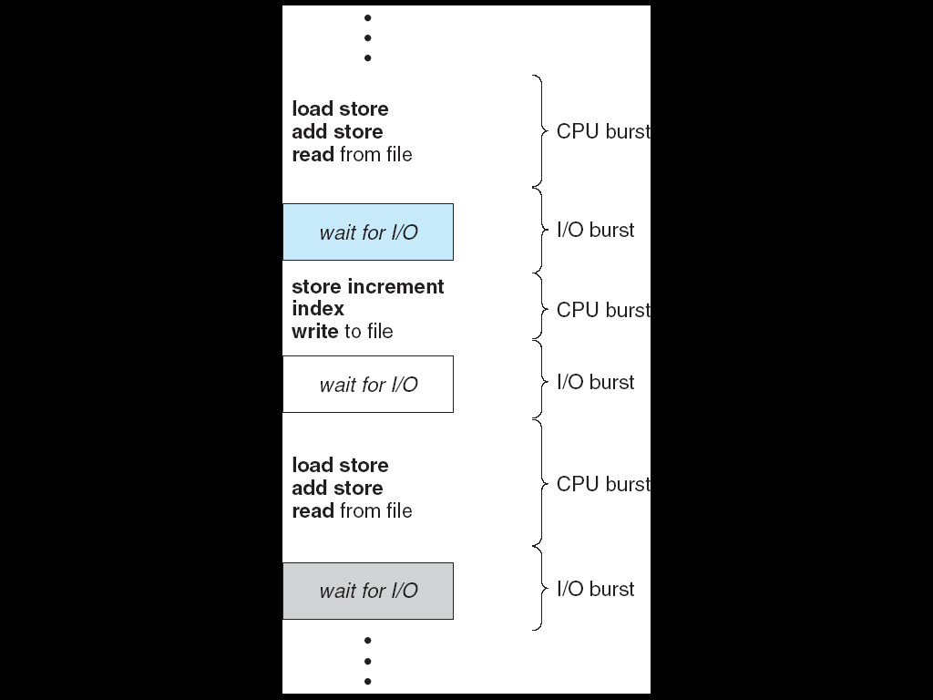
CPU/IO Bursts
A typical process alternates between bursts of CPU and I/O
It uses the CPU for some period of time, then does I/O, then uses CPU again (A process may be forced to give up CPU before finishing current CPU burst)
Notes:
Each scheduling decision is about which process to give to the CPU for use by its next CPU burst

Slide 3
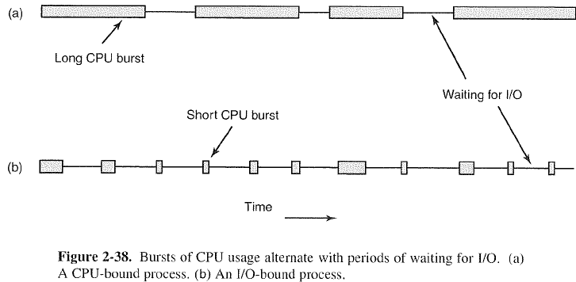
CPU-Bound vs. IO-Bound Processes

Slide 4
Terminology
By convention, we use the term “process” in this section, assuming that each process is single-threaded
The scheduling algorithms can be applied to threads as well
The term “job” is often used to refer to a CPU burst, or a compute-only process
Notes:
We use the term “job” to refer to a CPU burst of a process between two IO operations without IO (common in batch-processing systems)

Slide 5
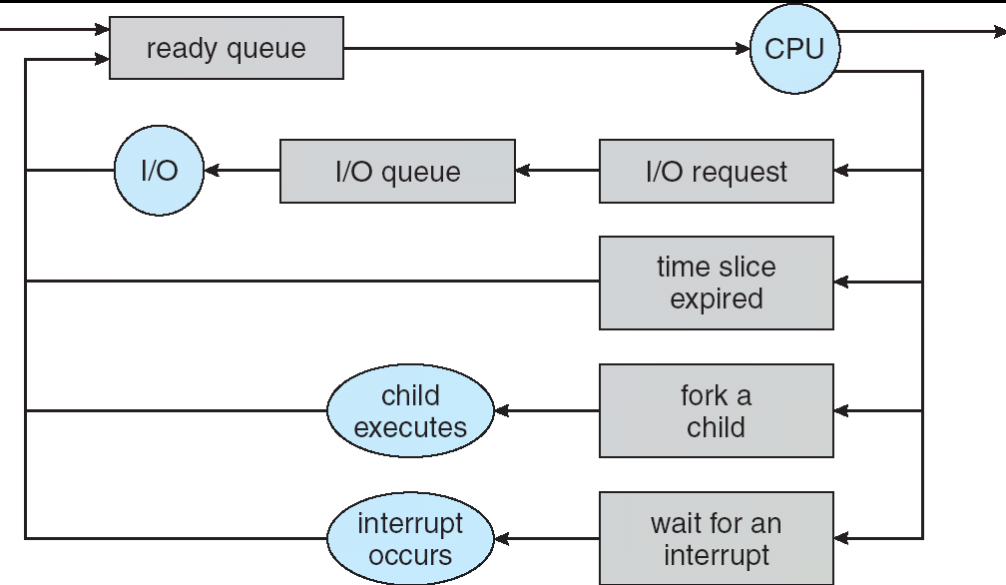
CPU Scheduling
When multiple processes are ready, the scheduling algorithm decides which one is given access to the CPU

Slide 6
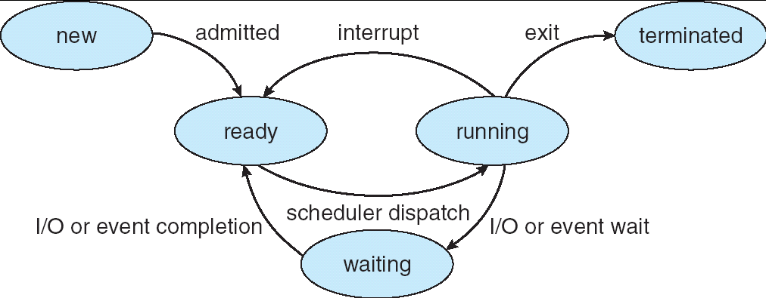
Preemptive vs. Non-Preemptive Scheduling
With non-preemptive scheduling, once the CPU has been allocated to a process, it keeps the CPU until it releases the CPU either by terminating or by blocking for IO.
With preemptive scheduling, the OS can forcibly remove a process from the CPU without its cooperation
Transition from “running” to “ready” only exists for preemptive scheduling

Slide 7
Scheduling Criteria
CPU utilization – percent of time when CPU is busy
Throughput – # of processes that complete their execution per time unit
Response time – amount of time to finish a particular process
Waiting time – amount of time a process waits in the ready queue before it starts execution

Slide 8
Scheduling Goals
Different systems may have different requirements
Maximize CPU utilization
Maximize Throughput
Minimize Average Response time
Minimize Average Waiting time
Typically, these goals cannot be achieved simultaneously by a single scheduling algorithm

Slide 9
Scheduling Algorithms Considered
First-Come-First-Served (FCFS) Scheduling
Round-Robin (RR) Scheduling
Shortest-Job-First (SJF) Scheduling
Priority-Based Scheduling
Multilevel Queue Scheduling
Multilevel Feedback-Queue Scheduling
Lottery Scheduling

Slide 10
First-Come, First-Served (FCFS) Scheduling
First-Come, First-Served (FCFS)
Also called “First In, First Out” (FIFO)
Run each job to completion in order of arrival
Example: Process Burst Time P₁ 24 P₂ 3 P₃ 3
Suppose processes arrive at time 0 almost simultaneously, but in the order: P₁ , P₂ , P₃ The Gantt Chart for the schedule is:
Waiting time for P₁ = 0; P₂ = 24; P₃ = 27
Average waiting time: (0 + 24 + 27)/3 = 17
Average response time: (24 + 27 + 30)/3 = 27
Convoy effect: short jobs queue up behind long job
P₁
P₂
P₃
0
24
27
30
Notes:
In early systems, FCFS meant one program scheduled until done (including I/O)
Now, means keep CPU until thread blocks

Slide 11
FCFS Scheduling (Cont.)
Example continued:
Suppose that jobs arrive in the order: P₂ , P₃ , P₁:
Waiting time for P₁ = 6; P₂ = 0; P₃ = 3
Average waiting time: (6 + 0 + 3)/3 = 3
Average response time: (3 + 6 + 30)/3 = 13
In second case:
Average waiting time is much better (before it was 17)
Average response time is better (before it was 27)
FCFS Pros and Cons:
Simple (+)
Convoy effect (-); performance depends on arrival order
P₂
P₃
P₁
0
3
6
30

Slide 12
Round Robin (RR)
Each process gets a small unit of CPU time (time quantum or time slice), usually 10-100 milliseconds
When quantum expires, if the current CPU burst has not finished, the process is preempted and added to the end of the ready queue.
If the current CPU burst finishes before quantum expires, the process blocks for IO and is added to the end of the ready queue
n processes in ready queue and time quantum is q ⇒
Each process gets (roughly) 1/n of the CPU time
In chunks of at most q time units
No process waits more than (n-1)q time units
Notes:
If you are first in line at supermarket with milk, you don’t care who is behind you, on the other hand…

Slide 13
RR with Time Quantum 20
Example: Process Burst Time P₁ 53 P₂ 8 P₃ 68 P₄ 24
The Gantt chart is:
Waiting time for P₁=(68-20)+(112-88)=72 P₂=(20-0)=20 P₃=(28-0)+(88-48)+(125-108)=85 P₄=(48-0)+(108-68)=88
Average waiting time = (72+20+85+88)/4=66¼
Average response time = (125+28+153+112)/4 = 104½
RR Pros and Cons:
Better for short jobs, Fair (+)
Context-switch time adds up for long jobs (-)
P₁
P₂
P₃
P₄
P₁
P₃
P₄
P₁
P₃
P₃
0
20
28
48
68
88
108
112
125
145
153

Slide 14
Choice of Time Slice
How to choose time slice?
Too big?
Performance of short jobs suffers
Infinite (∞)?
Same as FCFS
Too small?
Performance of long jobs suffers due to excessive context-switch overhead
Actual choices of time slice:
Early UNIX time slice is one second:
Worked ok when UNIX was used by one or two people.
What if three users running? 3 seconds to echo each keystroke!
In practice:
Typical time slice today is between 10ms – 100ms
Typical context-switching overhead is 0.1ms – 1ms
Roughly 1% overhead due to context-switching
Notes:
Performance
q large ⇒ FCFS
q small ⇒ Interleaved
q must be large with respect to context-switch time, otherwise overhead is too high

Slide 15
FCFS vs. RR
Assuming zero-cost context-switching time, is RR always better than FCFS? No.
Example: 10 jobs, each take 100s of CPU time RR scheduler quantum of 1s All jobs start at the same time
Response times:
Both RR and FCFS finish at the same time
Average response time is much worse under RR!
Bad when all jobs same length
Job # | FCFS | RR
1 | 100 | 991
2 | 200 | 992
… | … | …
9 | 900 | 999
10 | 1000 | 1000

Slide 16
Consider the Previous Example
Process Burst Time P₁ 53 P₂ 8 P₃ 68 P₄ 24
RR Q=20:
P₁
P₂
P₃
P₄
P₁
P₃
P₄
P₁
P₃
P₃
0
20
28
48
68
88
108
112
125
145
153
Best FCFS:
P₂
[8]
P₄
[24]
P₁
[53]
P₃
[68]
0
8
32
85
153
P₃
[68]
P₁
[53]
P₄
[24]
P₂
[8]
Worst FCFS:
0
68
121
145
153
When jobs have uneven length, it seems to be a good idea to run short jobs first!

Slide 17
Earlier Example with Different Time Quanta
Quantum
P₁
P₂
P₃
P₄
Average
Wait
Time
Best FCFS
32
0
85
8
31¼
Q = 1
84
22
85
57
62
Q = 5
82
20
85
58
61¼
Q = 8
80
8
85
56
57¼
Q = 10
82
10
85
68
61¼
Q = 20
72
20
85
88
66¼
Worst FCFS
68
145
0
121
83½
Response
Time
Best FCFS
85
8
153
32
69½
Q = 1
137
30
153
81
100½
Q = 5
135
28
153
82
99½
Q = 8
133
16
153
80
95½
Q = 10
135
18
153
92
99½
Q = 20
125
28
153
112
104½
Worst FCFS
121
153
68
145
121¾

Slide 18
Shortest-Job First (SJF) Scheduling
This algorithm associates with each process the length of its next CPU burst (job)
The process with shortest next CPU burst is chosen
Idea is to get short jobs out of the system; Big effect on short jobs, only small effect on long ones; Result is better average response time
Problem: is length of a job known at its arrival time?
Generally no; possible to predict
Notes:
In other words, this algorithm can be also regard as shortest-next-cpu-burst algorithm Shortest Job First (SJF):
Non-preemptive version: run the job with the least amount of computation to do (shortest next CPU burst)
Preemptive version: if job arrives and has a shorter time to completion than the remaining time on the current job, immediately preempt CPU
These can be applied either to a whole program or the current CPU burst of each program
Idea is to get short jobs out of the system
Big effect on short jobs, only small effect on long ones
Result is better average response time
But process running times are generally unknown at arrival time

Slide 19
Two Versions
Non-preemptive – once a job starts executing, it runs to completion
Preemptive – if a new job arrives with remaining time less than remaining time of currently-executing job, preempt the current job.
Also called Shortest-Remaining-Time-First (SRTF)
Notes:
cannot be preempted until it completes

Slide 20
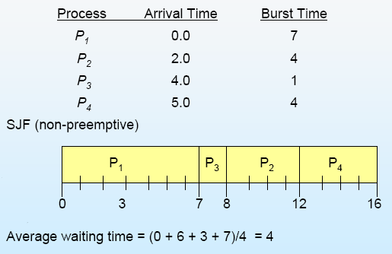
Short job first scheduling- Non-preemptive

Slide 21
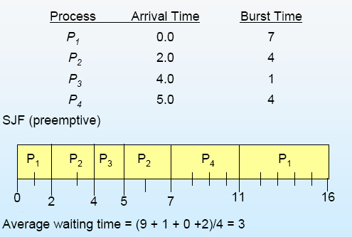
Short job first scheduling- Preemptive

Slide 22
Example to Illustrate Benefits of SRTF
A or B
C
C’s
I/O
C’s
I/O
C’s
I/O
Three processes:
A,B: both CPU bound, each runs for a week C: I/O bound, loop 1ms CPU, 9ms disk I/O
If only one at a time, C uses 90% of the disk, A or B use 100% of the CPU
With FCFS:
Once A or B get in, keep CPU for two weeks
Notes:
Easier to see with a timeline
What about RR or SRTF?

Slide 23
Example continued:
Disk Utilization:
9/201 ~ 4.5%
C
A
B
C
C’s
I/O
C’s
I/O
RR 100ms quantum
Disk Utilization:
~90% but lots of wakeups!
CABAB…
C
RR 1ms quantum
C’s
I/O
C’s
I/O
Disk Utilization:
90%
C
A
A
A
SRTF: C gets CPU whenever it needs
C’s
I/O
C’s
I/O

Slide 24
Discussions
SJF/SRTF are provably-optimal algorithms for minimizing average response time (SJF among non-preemptive algorithms, SRTF among preemptive algorithms)
SRTF is always at least as good as SJF
Comparison of SRTF with FCFS and RR
What if all jobs have the same length?
SRTF becomes the same as FCFS (i.e. FCFS is optimal if all jobs have the same length)
What if CPU bursts have varying length?
SRTF (and RR): short jobs not stuck behind long ones
Notes:
SJF is optimal – gives minimum average waiting time for a given set of processes among all non-preemptive scheduling algorithms

Slide 25
SRTF Discussions Cont’
Starvation
Long jobs never get to run if many short jobs
Need to predict the future
Some systems ask the user to provide the info
When you submit a job, have to say how long it will take
To stop cheating, system kills job if takes too long
But: even non-malicious users have trouble predicting runtime of their jobs
In reality, can’t really know how long job will take
However, can use SRTF as a yardstick for measuring other policies
Optimal, so can’t do any better
SRTF Pros & Cons
Optimal (average response time) (+)
Hard to predict future (-)
Unfair (-)
Notes:
Can lead to starvation if many small jobs!

Slide 26
Priority-Based Scheduling
A priority number (integer) is associated with each process; CPU is allocated to the process with the highest priority
(Convention: smallest integer ≡ highest priority)
Can be preemptive or non-preemptive
SJF/SRTF are special cases of priority-based scheduling where priority is the predicted next/remaining CPU burst time
Starvation – low priority processes may never execute
Sometimes this is the desired behavior!

Slide 27
Multi-Level Queue Scheduling
Ready queue is partitioned into multiple queues
Each queue has its own scheduling algorithm
e.g., foreground queue (interactive processes) with RR scheduling, and background queue (batch processes) with FCFS scheduling
Scheduling between the queues
Fixed priority, e.g., serve all from foreground queue, then from background queue
Notes:
foreground (interactive) background (batch)
foreground – RR
background – FCFS
Time slice – each queue gets a certain amount of CPU time which it can allocate amongst its processes
i.e., 80% to foreground in RR; 20% to background in FCFS

Slide 28
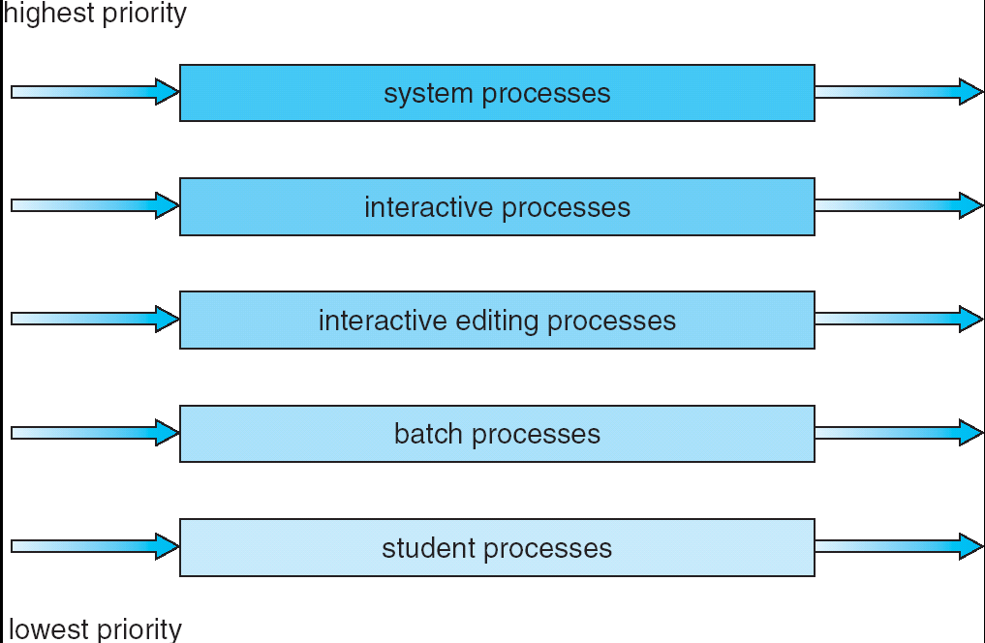
Multilevel Queue Scheduling

Slide 29
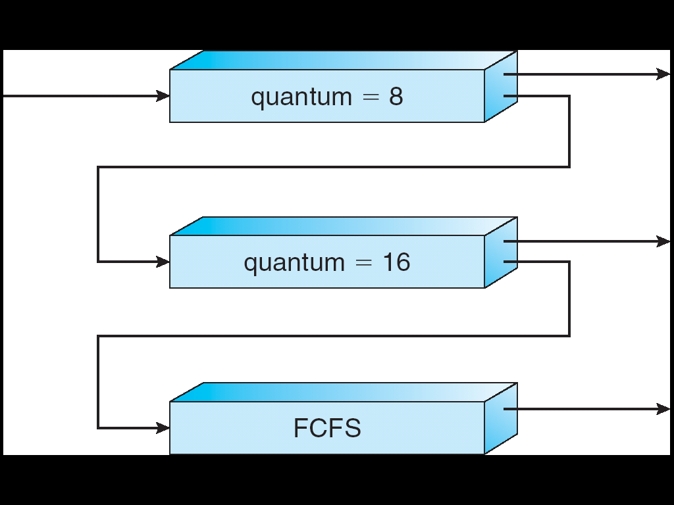
Multi-Level Feedback Queue Scheduling
Long-Running Compute Jobs Demoted to Low Priority
Similar to Multi-Level Queue Scheduling, but dynamically adjust each process’ priority as follows
It starts in highest-priority queue
If quantum expires before the CPU burst finishes, drop one level
If it blocks for IO before quantum expires, push up one level (or to top, depending on implementation)
Notes:
Another method for exploiting past behavior
First used in CTSS
Multiple queues, each with different priority
Higher priority queues often considered “foreground” processes
Each queue has its own scheduling algorithm
e.g. foreground – RR, background – FCFS
Sometimes multiple RR priorities with quantum increasing exponentially (highest:1ms, next:2ms, next: 4ms, etc)
Scheduling between the queues
Fixed priority scheduling: serve all from highest priority, then next priority, etc.

Slide 30
Scheduling Details
Result approximates SRTF:
CPU-bound processes are punished and drop like a rock
Short-running I/O-bound processes are rewarded and stay near top
No need for prediction of job runtime; rely on past behavior to make decision
User action can foil intent of the OS designer
e.g., put in a bunch of meaningless I/O like printf() to keep process in the high-priority queue
Of course, if everyone did this, this trick wouldn’t work!
Notes:
Example of Othello program:
Playing against competitor, so key was to do computing at higher priority the competitors.
Put in printf’s, ran much faster!
Scheduling between the queues
Fixed priority scheduling:
serve all from highest priority, then next priority, etc.
Time slice:
each queue gets a certain amount of CPU time, e.g., 70% to highest, 20% next, 10% lowest

Slide 31
Lottery Scheduling
Unlike previous algorithms that are deterministic, this is a probabilistic scheduling algorithm
Give each process some number of lottery tickets
On each time slice, randomly pick a winning ticket
On average, CPU time is proportional to number of tickets given to each process
How to assign tickets?
To approximate SRTF, short running processes get more, long running jobs get fewer
To avoid starvation, every process gets at least a min number of tickets (everyone makes progress)
Notes:
Advantage: behaves gracefully as load changes Adding or deleting a process affects all jobs proportionally, independent of how many tickets each job possesses

Slide 32
Lottery Scheduling Example
Assume each short process get 10 tickets; each long process get 1 ticket
# short procs/ # long procs | % of CPU each short proc gets | % of CPU each long proc gets
1/1 | 91% | 9%
0/2 | N/A | 50%
2/0 | 50% | N/A
10/1 | 9.9% | 0.99%
1/10 | 50% | 5%
Notes:
What if too many short processes to give reasonable response time?
In UNIX, if load average is 100, hard to make progress
One approach: log some user out

Slide 33
Summary
Scheduling: selecting a waiting process from the ready queue and allocating the CPU to it
FCFS Scheduling:
Pros: Simple
Cons: Short jobs can get stuck behind long ones
Round-Robin Scheduling:
Pros: Better for short jobs
Cons: Poor performance when jobs have same length
Notes:
Give each thread a small amount of CPU time when it executes; cycle between all ready threads

Slide 34
Summary Cont’
Shortest Job First (SJF) and Shortest Remaining Time First (SRTF)
Run the job with least amount of computation to do/least remaining amount of computation to do
Pros: Optimal (average response time)
Cons: Hard to predict future, Unfair
Priority-Based Scheduling
Each process is assigned a fixed priority
Multi-Level Queue Scheduling
Multiple queues of different priorities
Multi-Level Feedback Queue Scheduling:
Automatic promotion/demotion of process between queues
Lottery Scheduling:
Give each process a number of tickets (short tasks ⇒ more tickets)
Reserve a minimum number of tickets for every process to ensure forward progress
See animations of common scheduling algorithms
Notes:
in order to approximate SJF/SRTF

